Slide 1
Facilitating the Deployment of the 5G Network
A project by Manas Vardhan

Slide 2

The idea
The project is about optimum deployment of 5G network to cover neighbourhoods in the city of Toronto. The project is completed in Google Colab and is built in python and uses Folium for Data Visualization. The data gathered for the project has roots from wikipedia and a robust API for Geospatial Data called Foursquare API.

Slide 3

.
Everything you need to know about 5G
5G is the 5th generation mobile network. It is a new global wireless standard after 1G, 2G, 3G, and 4G networks. 5G enables a new kind of network that is designed to connect virtually everyone and everything together including machines, objects, and devices.
5G wireless technology is meant to deliver higher multi-Gbps peak data speeds, ultra low latency, more reliability, massive network capacity, increased availability, and a more uniform user experience to more users. Higher performance and improved efficiency empower new user experiences and connects new industries.

Slide 4
5G and the economy
5G is driving global growth.
• $13.2 Trillion dollars of global economic output
• 22.3 Million new jobs created
• $2.1 Trillion dollars in GDP growth
Through a landmark 5G Economy study, we found that 5G’s full economic effect will likely be realized across the globe by 2035—supporting a wide range of industries and potentially enabling up to $13.2 trillion worth of goods and services.

Slide 5
This impact is much greater than previous network generations. The development requirements of the new 5G network are also expanding beyond the traditional mobile networking players to industries such as the automotive industry.
The study also revealed that the 5G value chain (including OEMs, operators, content creators, app developers, and consumers) could alone support up to 22.3 million jobs, or more than one job for every person in Beijing, China. And there are many emerging and new applications that will still be defined in the future. Only time will tell what the full “5G effect” on the economy is going to be.

Slide 6

A few challenges with 5G

Slide 7
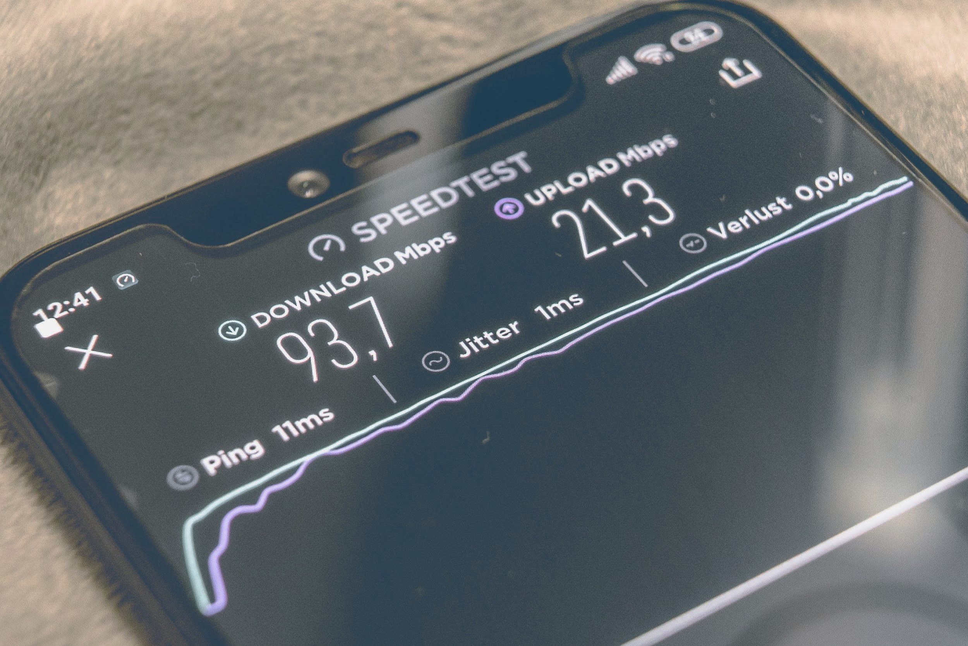
Technological Challenges
Inter-cell Interference − This is one of the major technological issues that need to be solved. There is variations in size of traditional macro cells and concurrent small cells that will lead to interference.
Efficient Medium Access Control − In a situation, where dense deployment of access points and user terminals are required, the user throughput will be low, latency will be high, and hotspots will not be competent to cellular technology to provide high throughput. It needs to be researched properly to optimize the technology.

Slide 8
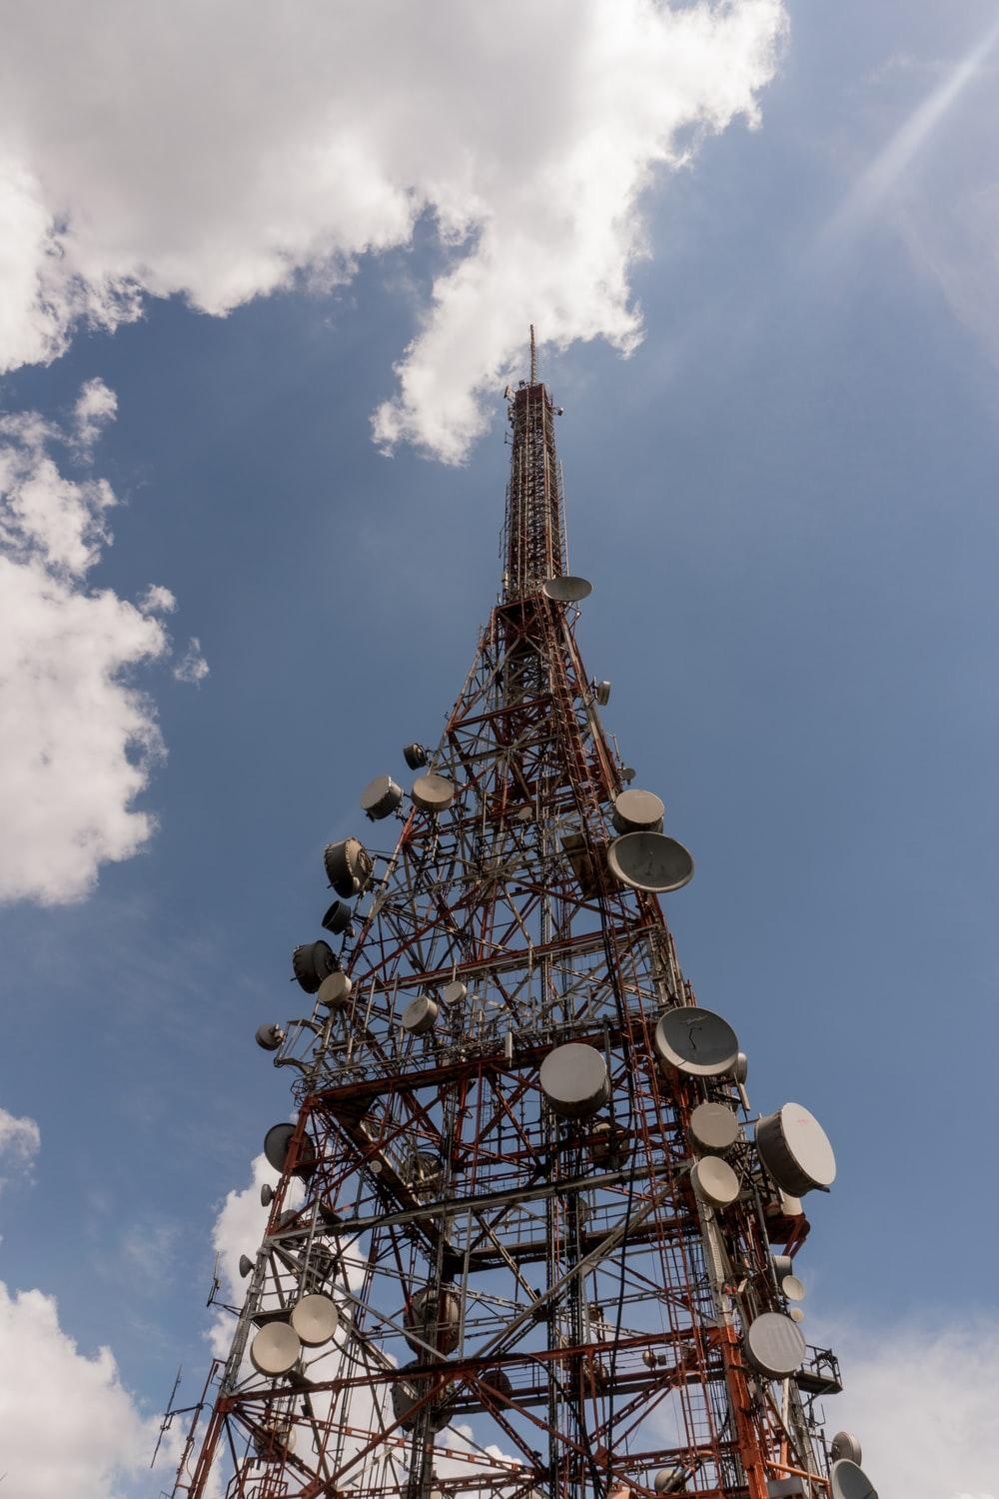
Aim
The aim is to address the second problem, the problem of Efficient Medium access Control by Clustering neighborhoods to see Geospatial similarities between them to deploy Towers and connecting hotspots at optimum points.

Slide 9
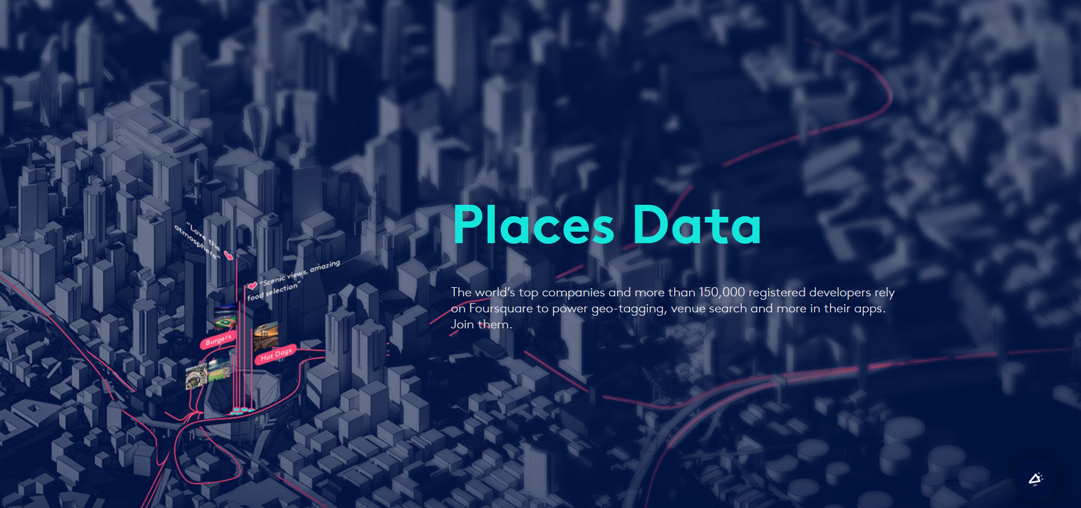
Foursquare API

Slide 10

The project makes use of two m
ain Data sources Wikipedia
Foursquare API
The data used is Geospatial Data visualized using Folium which is an open source Map Visualization Library and then the data obtained is clustered.
The results are verified using venue data obtained from Foursquare API to solidify the clustering results
This gives us with three clusters with Geospatial similarities and techniques can be applied to manage the network coverage in the three independent clusters for deployment of robust 5G network.

Slide 11
Who’d be interested
A majority of telecom companies are in the race of deploying 5G networks as fast as possible. Owing to the huge business impact and large scale deployability of the network, Companies like AT&T are willing to shell millions of dollars
With the recent development in smartphone technologies, telecom-smartphone tie ups have become a common thing. Another spectrum of audience this project can attract is the Smartphone market . Readily available 5G phones are finding it hard to get connected to fast 5G network these days, these tie ups between companies and joint ventures would make use of this project for reducing business costs and increasing network quality.

Slide 12
Methodology
The project scrapes data off wikipedia to gather Geospatial Data about neighborhoods in Toronto and then applies elbow method to it to find out optimal cluster number, Once found , clustering is applied and the map is re-visualized.
The results are validated by taking venue data
( common marketplaces, restaurants, pubs,coffeehouses) and the same elbow method is applied to find the optimum number of clusters in it, followed by clustering and subsqeuent map visualizations.
Inferences are drawn after these processes.
Source: travel.trade.gov

Slide 13
Results
The results show great magnitude of similarity between the neighborhood data and the venue data gathered from two independent sources and stored in two independent dataframes
The degree of similarity was visible through plotting the geospatial data points via folium.
Another noticeable similarity between the two were the number of clusters in the data. Both datasets attained optimality at 3 clusters.
On plotting those clusters, the cluster specifications were exceedingly similar to one another thereby validating our results.

Slide 14
Discussions and Suggestions
The central tower be placed at the centroid of the three clusters
The methodology can be scaled through multiple cities and can self validate its results
Three independent 5G networks be deployed (as number of clusters is 3 )

Slide 15
Conclusion
The deployment of 5G has almost just started in the modern world with a few hotspots spread across the Europe and the United States. A lot of deployment cost can be cut and high quality of 5G connectivity can be ensured using good statistical and Machine Learning Methods.
Data Science applied to the field while deployment of networks can ensure safe, secure and easy installations connecting masses through ultra high speed connections and simultaneously generate revenue to the companies by getting work done quickly and efficiently

